Slide 1
Web Scraping with Python
Aidan Sullivan, Ryan Gilmore, Lo-Badal Burch

Slide 2
What is Web Scraping?
Gathering data from web pages and social media
Filtering data into structured and readable formats
Not all data on websites is available as an excel document or fetchable with an API
In these cases we need to write our own software to gather this data

Slide 3
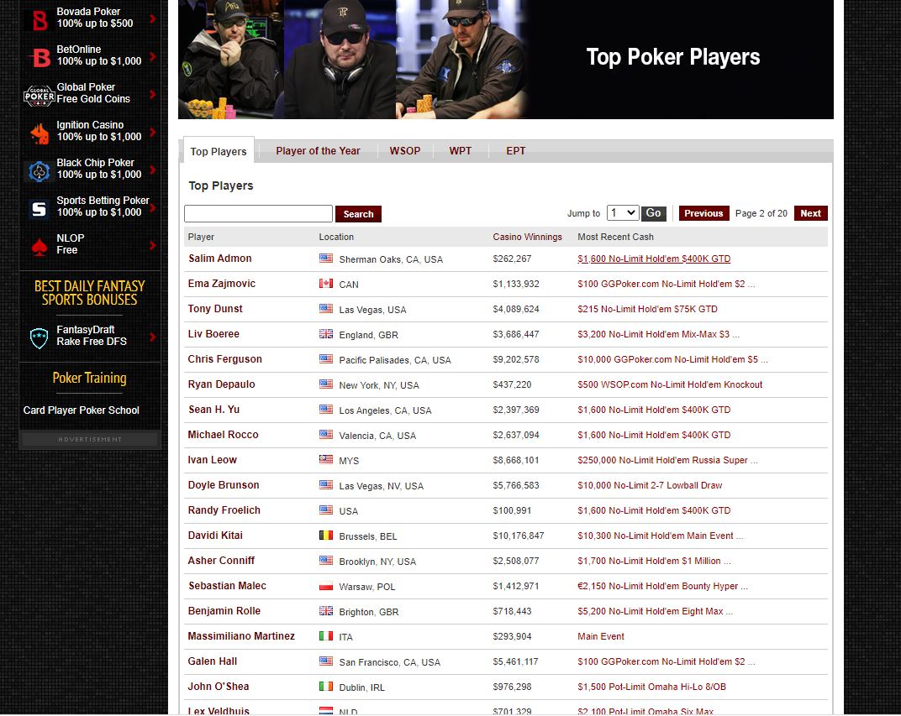
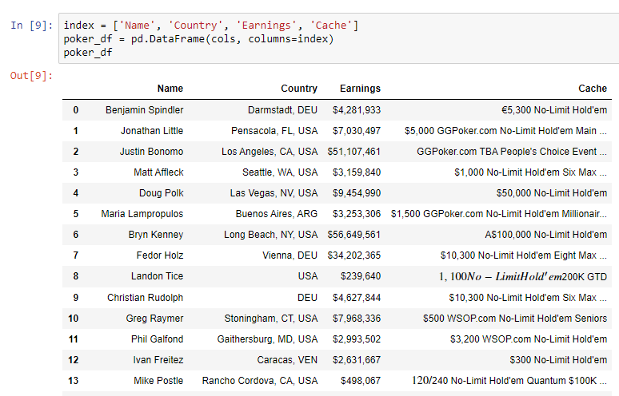


Slide 4
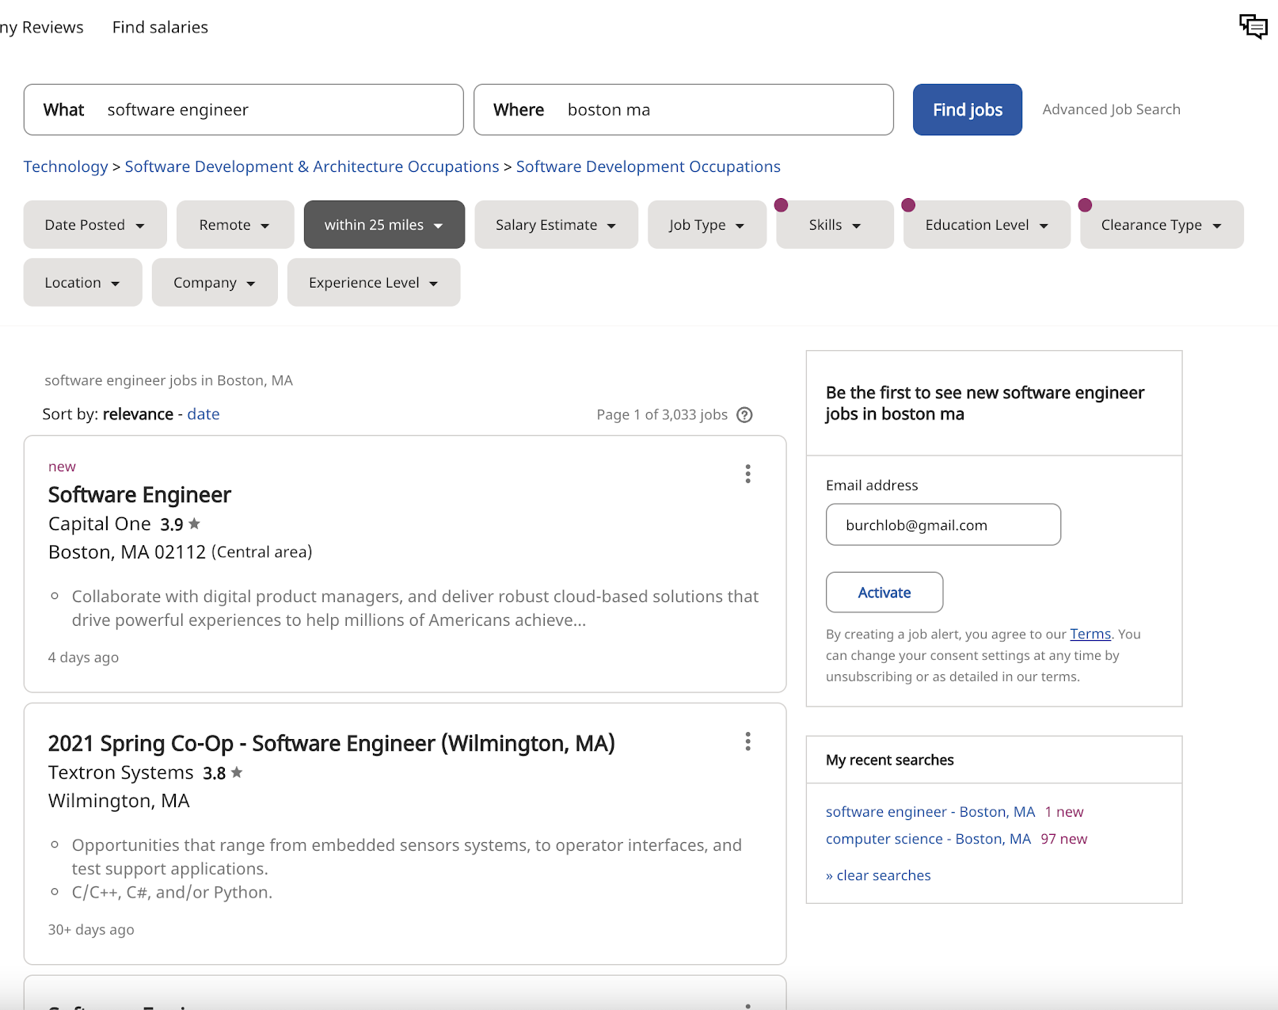
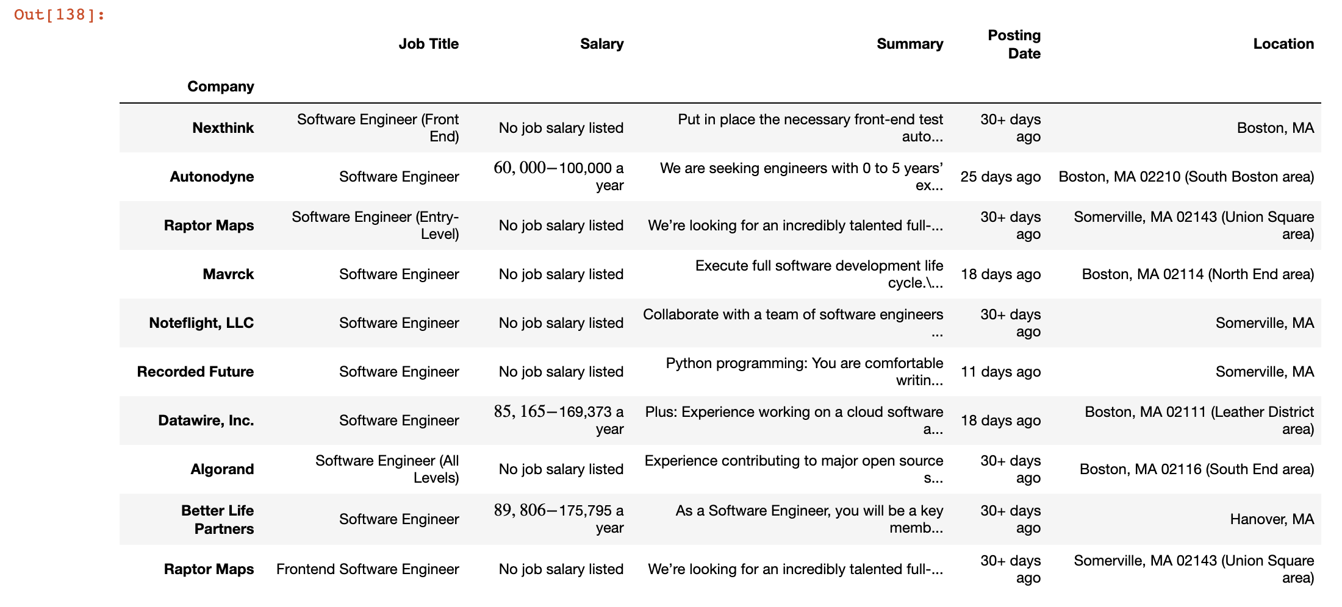

Slide 5
Why Web Scraping?
Filtering through job postings on websites like Indeed is tedious
With web scraping we can expedite our job searches
Many of us are interested in data science
Web scraping is a useful tool for gathering large data sets

Slide 6
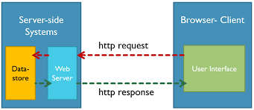
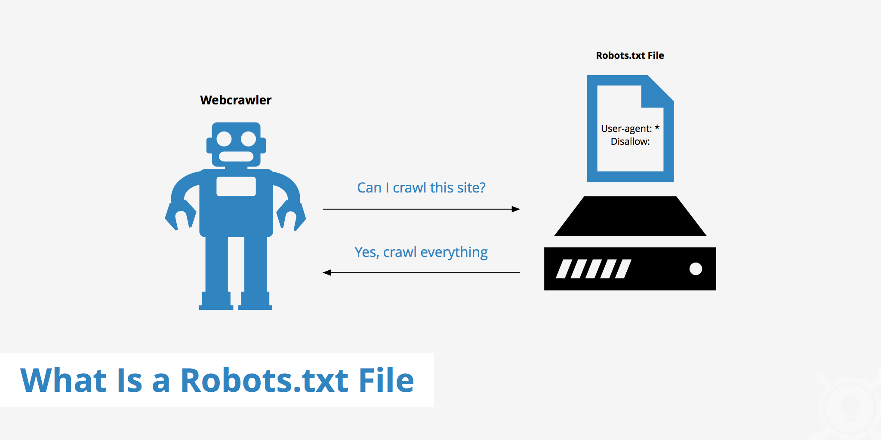
Networking of Scraping
Our project deals entirely in the application layer, dealing with http requests and responses
Bots can potentially make thousands of requests within seconds
Too many requests can flood the bandwidth of the host - huge loss of $$$
Need to make sure to follow websites rules i.e robots.txt
We request infrequently for needed files to minimize our effect on host bandwidth

Slide 7
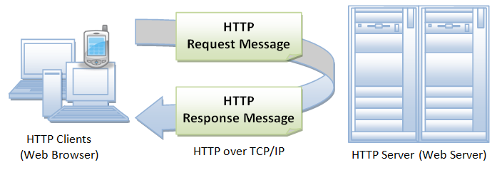


Our Program
Libraries and packages:
Python’s requests for HTTP request and response
BeautifulSoup for HTML parsing
Pandas for storing our data
Basic flow of program:
Gather relevant URLs
Request and response from first URL
Parse through HTML doc for relevant data
Add new data to dataset
Repeat process for the remaining URLs

Slide 8
DEMO

Slide 9
Challenges and Solutions
Websites have data we want spread out across multiple pages
Requesting all pages at once breaks the websites protocols
Added a time delay to our requests to minimize our impact on bandwidth
HTML data is specific to web pages
Parser requires we search for data by text or HTML tag
No real way to write generalized code
Solution was to study website source and adjust our code.

Slide 10
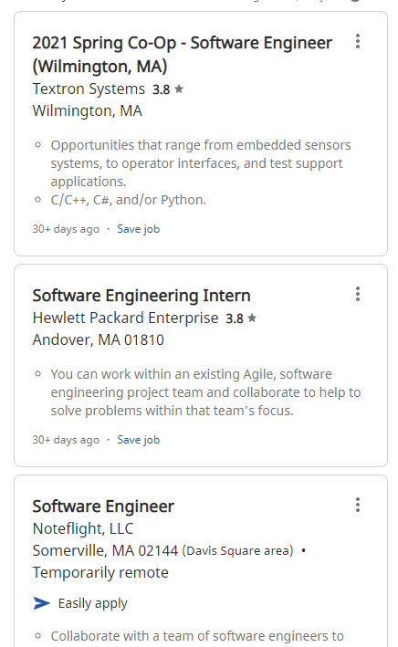
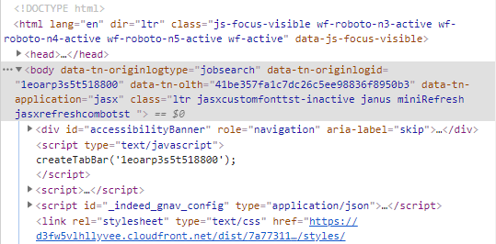

Slide 11
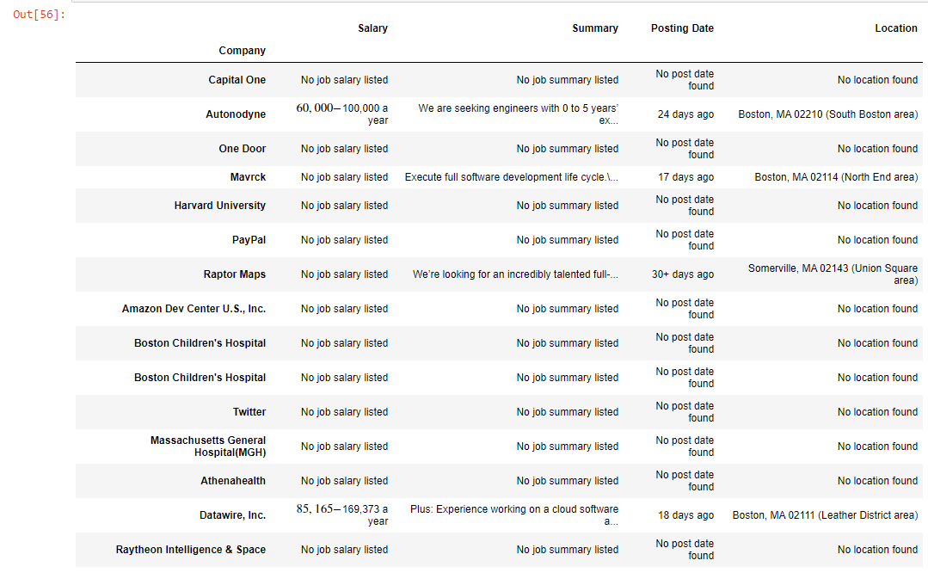

Slide 12
Other Solutions
Text pattern matching
Vertical Integration
Machine Learning/Image Discrimination

Slide 13
What’s Next?
With more time we’d like to fill in the gaps in our data and perfect our current method of parsing
Going forward we’ll be using the datasets we gather for machine learning projects
Predicting winners of upcoming poker tournaments
Job market analysis

